Slide 1


Integrating MedCLIP and Cross-Modal Fusion for Automatic Radiology Report Generation
Qianhao Han, Junyi Liu, Zengchang Qin, Zheng Zheng
IEEE BigData 2024 Conference Undergraduate and High School Symposium
Notes:
Name, Grade 10, BSS, Toronto, Canada
excited to be here, first time, etc
Today I will present our collaborative work:
Integrating MedCLIP and Cross-Modal Fusion for Automatic Radiology Report Generation

Slide 2
Outline
Introduction
Background & Related Work
Proposed Framework
Experimental Results
Case Study
Conclusion & Future Work
Qianhao Han
Integrating MedCLIP and Cross-Modal Fusion for Automatic Radiology Report Generation

Slide 3
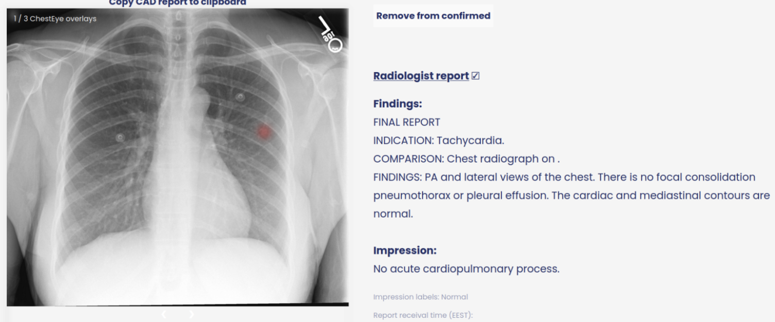

Introduction
Research Motivation & Purpose
Qianhao Han
Integrating MedCLIP and Cross-Modal Fusion for Automatic Radiology Report Generation
Notes:
Radiology reports are documents written by radiologists that explain what they see in medical images like X-rays, MRIs, or CT scans. An example is shown on the slide.
Research Motivation
Medical imaging is important to clinical diagnosis because it helps doctors understand the results and decide on the best treatment for their patients.
However, radiologists face the challenge of time-consuming manual report writing and there is potential for bias and errors, especially among less experienced radiologists
Therefore, the purpose of the research…
Automating radiology report generation to reduce radiologists' workload and improve clinical documentation
allowing radiologists to focus on critical decision-making

Slide 4
Related Works
Conventional Encoder-Decoder Architecture
CNNs & RNNs or non-recurrent networks
Transformer-based models
Use of knowledge graphs [Zhang et al., EMNLP‘20]
Multi-modal transformer models with memory mechanisms [Chen et al., ACL-IJCNLP‘21]
Vision-language pre-training models
CLIP [Radford et al., PMLR ‘21]
MedCLIP [Wang et al., EMNLP‘22]
Qianhao Han
Integrating MedCLIP and Cross-Modal Fusion for Automatic Radiology Report Generation
Notes:
Most existing works rely on a conventional encoder-decoder architecture, integrating CNNs for image feature extraction with RNNs or non-recurrent networks for description generation
These approaches struggle with generating long, detailed reports due to limited feature capture of radiology images
Shift towards using transformer-based models
Transformers are well-suited for handling sequential data efficiently, making them ideal for generating descriptive and diagnostic reports.
Notable advancements include the use of knowledge graphs by Zhang et al., multi-modal transformer models with memory mechanisms by Chen et al
Additionally, research has moved towards vision-language pre-training models such as CLIP and MedCLIP.

Slide 5
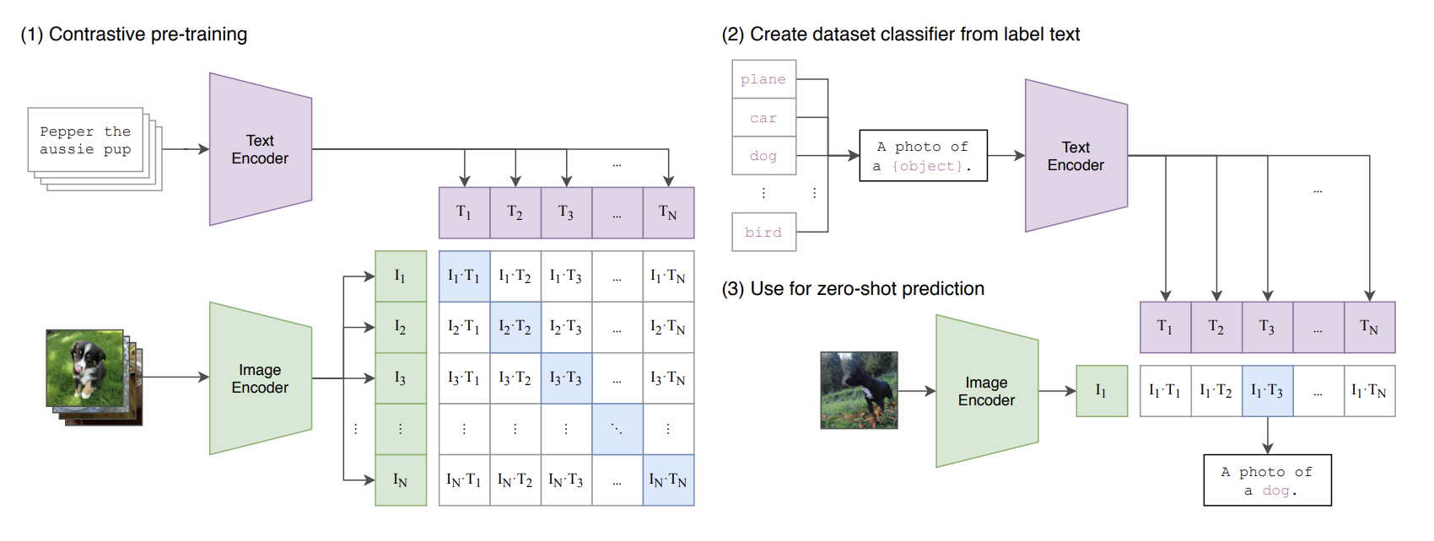
Related Work: CLIP
Qianhao Han
Integrating MedCLIP and Cross-Modal Fusion for Automatic Radiology Report Generation
Notes:
CLIP is trained on large datasets of image-text pairs and can perform tasks like image classification and image retrieval based on text without specific fine-tuning.
Unlike standard models, CLIP trains an image and text encoder together
connects images and text using contrastive learning, which aligns similar pairs of images and text and separates unrelated ones.

Slide 6
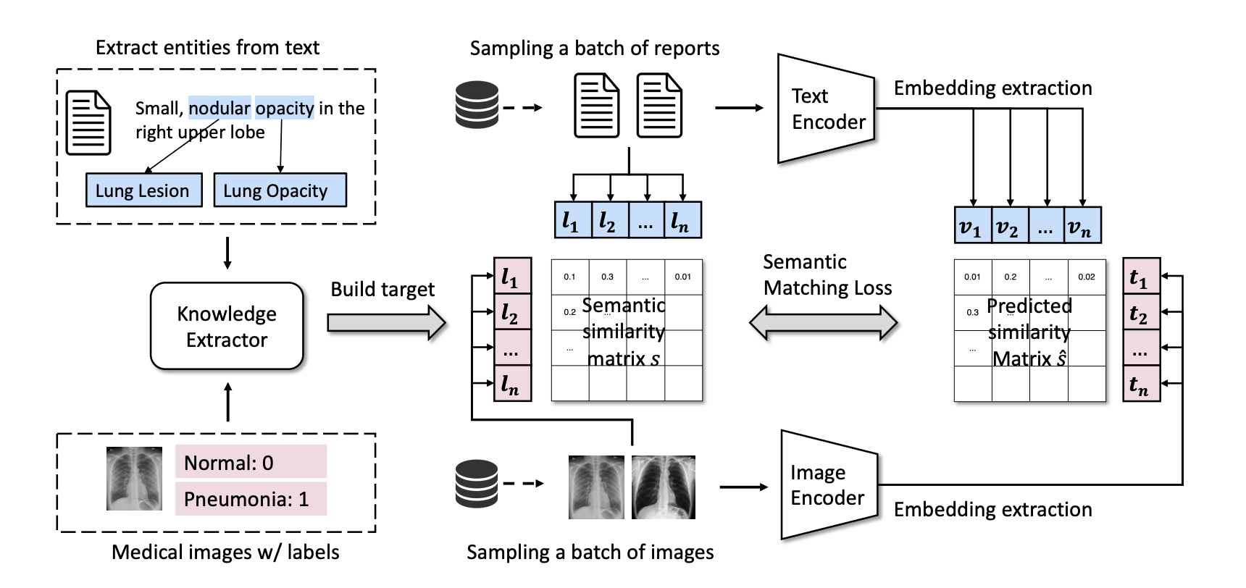
Related Work: MedCLIP
Qianhao Han
Integrating MedCLIP and Cross-Modal Fusion for Automatic Radiology Report Generation
Notes:
On the other hand, MedCLIP is built on CLIP’s architecture but is adapted specifically for medical purposes.
MedCLIP serves as a pre-trained model in our framework and significantly improves performance in generating medical reports by combining visual and text-based data.

Slide 7
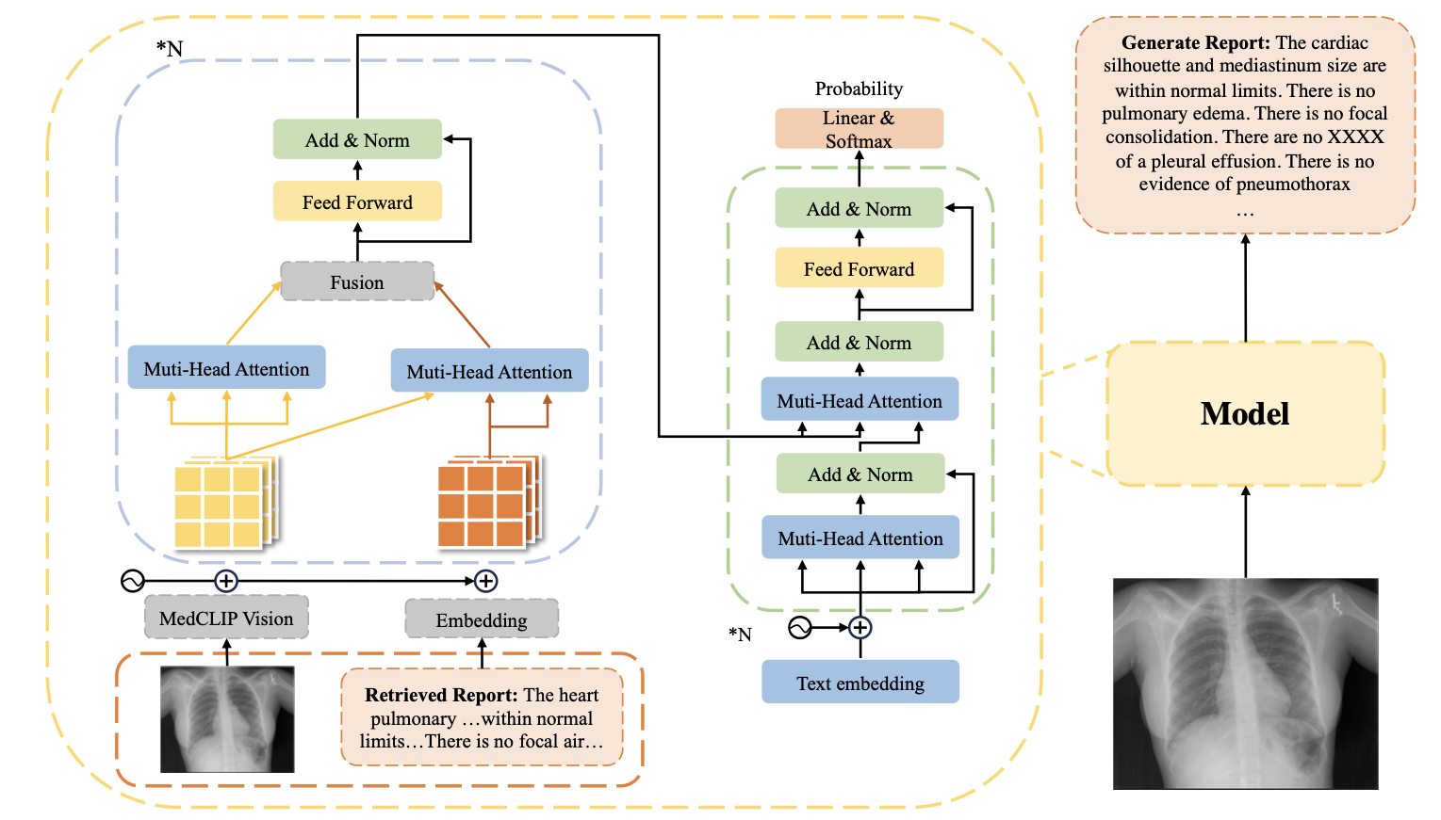
Proposed Framework
A: Similar Report Retrieval Module
B: Feature Extraction Fusion Module
C: Report Generation Module
Qianhao Han
Integrating MedCLIP and Cross-Modal Fusion for Automatic Radiology Report Generation
Notes:
Our framework is made up of three main parts: a retrieval module, a fusion module, and a report generation module.
A: Similar Report Retrieval Module
The retrieval method, highlighted in red, is inspired by radiologists who often look at previous cases when creating new reports.
We use MedCLIP to help capture image features from a dataset, and then we use cosine similarity to find the most similar existing reports based on these features.
B: Feature Extraction Fusion Module (BLUE)
In this module, we combine the input image with the retrieved report, treating them as two separate sources of information. MedCLIP is used again here to pull out features from both the input image and the report text.
Self-Attention is applied first to focus on the most important parts of the image.
Cross-Attention then uses the image features as the "query" and the report features as the "key" and "value" to draw relevant details from the image.
We use a learnable parameter to blend the self-attention and cross-attention outputs, creating a fused feature that combines information from both the image and the report.
This fused feature is then utilized for the final report generation.
C: Report Generation Module (GREEN)
This part follows a classic encoder-decoder structure to generate the medical report. It uses the fusion features, along with a feed-forward network, to process the integrated image and text data.
We add dropout and layer normalization, to make training more stable and improve generalization.
Finally, a standard Transformer decoder generates the output report.
The model is trained by minimizing cross-entropy loss with actual reports as the ground truth, allowing it to improve its accuracy in generating medical text.

Slide 8
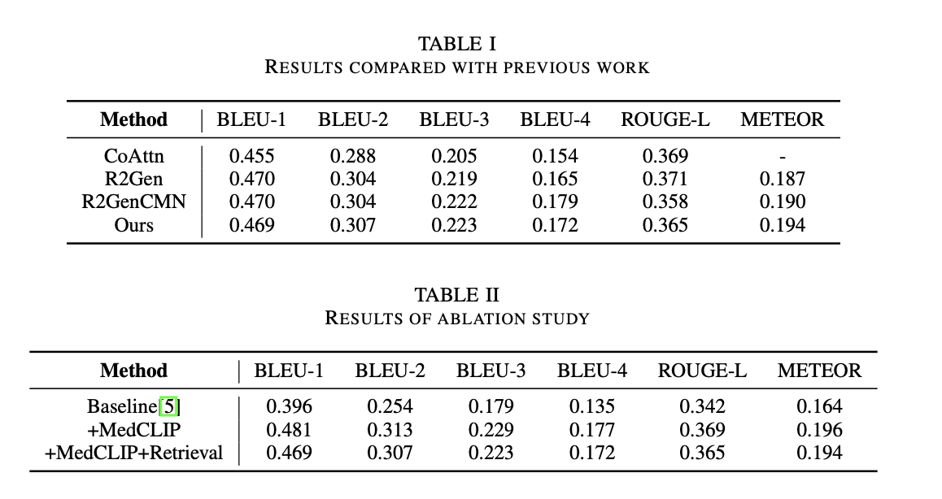

Experimental Results
Our method outperforms R2GenCMN in:
+0.3% → BLEU-2
+0.1% → BLEU-3
+0.7% → ROUGE-L
+0.4% → METEOR
Experimental settings:
Dataset: IU-Xray (3,955 reports and 7,470 images)
GPU: NVIDIA Tesla T4 16GB x2
CPU: 48 core, 186GB memory
Qianhao Han
Integrating MedCLIP and Cross-Modal Fusion for Automatic Radiology Report Generation
Notes:
We ran experiments on the IU-Xray benchmark dataset
training, validation, and test sets with a ratio of 7:1:2.
3,955 reports and 7,470 frontal and lateral radiology images
To run the experiments
We used two NVIDIA Tesla T4 16GB GPUs
The CPU is 48 core, 186GB of memory
To evaluate our model, we use the widely accepted Natural Language Generation metrics: BLEU, METEOR, and ROUGE- L.
We compare our approach with state-of-the-art methods CoAttn [10], R2Gen and R2GenCMN [4] on the IU-Xray dataset,
The results are shown in the first table
Our model outperforms R2GenCMN in several key metrics, specifically an increase of 0.3%, 0.1%, 0.7%, and 0.4% on BLEU-2, BLEU-3, ROUGE- L, and METEOR scores, respectively.
The increase in BLEU-2, BLEU-3, and ROUGE scores is due to the use of retrieved reports, which contain expressions similar to the Ground Truth, therefore improving the quality of the generated text.
The increase in the METEOR score results from MedCLIP capturing more medical visual features, allowing the generated report to focus on medical details.
Although there is a slight decrease in performance on the BLEU-1 and BLEU-4 scores, our model is still able to generate more accurate and fluent long-form reports, and focuses on medically relevant details.
Ablation study:
Table II shows the main results of our ablation studies.
The baseline reflects the performance of using the classic Transformer architecture from R2GenCMN.
Using the MedCLIP vision extractor improves metrics comprehensively due to its ability to extract both visual and textual features through contrastive learning.
However, when retrieval modules are introduced, there is a slight decline in performance. This is likely due to errors or redundancies present in the retrieved reports, as MedCLIP already captures sufficient textual information.

Slide 9
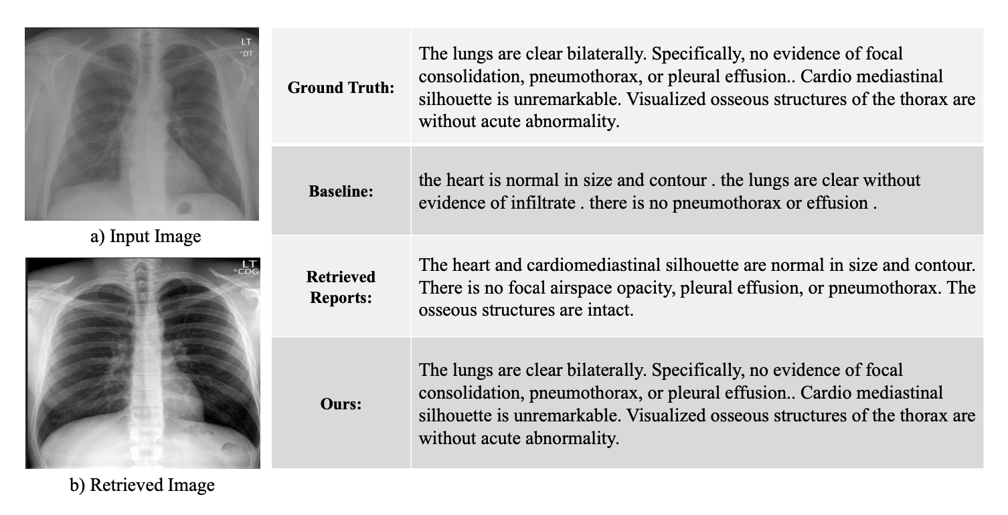
Case Study
Qianhao Han
Integrating MedCLIP and Cross-Modal Fusion for Automatic Radiology Report Generation
Notes:
To validate our results, we selected a challenging case from the IU-Xray dataset and compared our method with the Transformer baseline model. The results are shown in the table
The baseline model has two main issues
Inconsistencies between the generated reports and ground truth
“no evidence of focal consolidation, pneumothorax, or pleural effusion" is simplified to "there is no pneumothorax or effusion."
Certain important features are missing completely
such as "cardio mediastinal silhouette" and "osseous (awseeyes) structures," are missing entirely
Our approach retrieves a similar image and report from a report database, shown in the table,
The retrieved report contains key terms that the transformer baseline model that were missing such as “pneumothorax, or pleural effusion” and "osseous structures,"
Using this similar report improves the quality and details in our generated report so our generated report is very similar to the ground truth

Slide 10
Conclusions & Future Work
Conclusions:
Developed a cross-modal framework with potential to be applied in automatic medical radiology report generation
Uses MedCLIP to extract features from both images and retrieved reports
Effective results on benchmark datasets
Future Work:
Challenges: errors/redundancies in retrieved reports
Refine retrieval accuracy and add filtering mechanisms
Use MedCLIP for other intelligent medical diagnosis
Qianhao Han
Integrating MedCLIP and Cross-Modal Fusion for Automatic Radiology Report Generation
Notes:
In conclusion, we introduced a new cross-modal framework for generating medical reports. There is potential for this to be applied in automatic medical radiology report generation.
Our framework uses MedCLIP not just as a visual extractor but also as a report retriever. The key is the fusion module, which combines features from both images and retrieved reports, allowing the model to effectively learn cross-modal information.
Our experiments on public benchmark datasets showed that this framework is indeed effective.
However, we did notice some challenges, mainly potential errors or redundancies in the reports that were retrieved.
This points to a direction for future research, which is refining the retrieval process to boost accuracy and adding filtering mechanisms to handle those redundancies better.
Lastly, there’s great potential for MedCLIP to be used in broader applications for intelligent medical diagnosis.

Slide 11
References
[1] Zhihong Chen, Yaling Shen, Yan Song, and Xiang Wan. Cross-modal memory networks for radiology report generation. In Proceedings of the 59th Annual Meeting of the Association for Computational Linguistics and the 11th International Joint Conference on Natural Language Processing, pages 5904–5914, 2021.
[2] Zhihong Chen, Yaling Shen, Yan Song, and Xiang Wan. Cross-modal memory networks for radiology report gen- eration. Proceedings of the Joint Conference of the 59th Annual Meeting of the Association for Computational Linguistics and the 11th International Joint Conference on Natural Language Processing, 2021.
[3] Dina Demner-Fushman, Marc D Kohli, Marc B Rosenman, Sonya E Shooshan, Laritza Rodriguez, Sameer Antani, George R Thoma, and Clement J McDonald. Preparing a collection of radiology examinations for distribution and retrieval. Journal of the American Medical Informatics Association, 23(2):304–310, 2016.
[4] Kaiming He, Xiangyu Zhang, Shaoqing Ren, and Jian Sun. Deep residual learning for image recognition. pages 770– 778. IEEE Conference on Computer Vision and Pattern Recognition (CVPR), 2016.
[5] Baoyu Jing, Pengtao Xie, and Eric Xing. On the automatic generation of medical imaging reports. In proceedings of the 56th Annual Meeting of the Association for Computational Linguistics, pages 2577–2586, 2018.
[6] Guanxiong Liu, Tzu-Ming Harry Hsu, Matthew McDermott, Willie Boag, Wei-Hung Weng, Peter Szolovits, and Marzyeh Ghassemi. Clinically accurate chest x-ray report generation. In Proceedings of the Machine Learning for Healthcare Conference, pages 249–269, 2019.
[7] Alec Radford, Jong Wook Kim, Chris Hallacy, Aditya Ramesh, Gabriel Goh, Sandhini Agarwal, Girish Sas- try, Amanda Askell, Pamela Mishkin, and Jack Clark. Learning transferable visual models from natural language supervision. page 8748–8763. In International Conference on Machine Learning, PMLR, 2021.
[8] Zifeng Wang, Zhenbang Wu, Dinesh Agarwal, and Jimeng Sun. Medclip: Contrastive learning from unpaired medical images and text. pages 3876–3887. Conference on Empirical Methods in Natural Language Processing, EMNLP, 2022.
Qianhao Han
Integrating MedCLIP and Cross-Modal Fusion for Automatic Radiology Report Generation

Slide 12
Thank you!
Any Questions?
Qianhao Han (High School Grade 10)
qianhaoh27@bss.on.ca

